Slide 1
Lecture 04
Hash Pointers and Data Structures

Slide 2
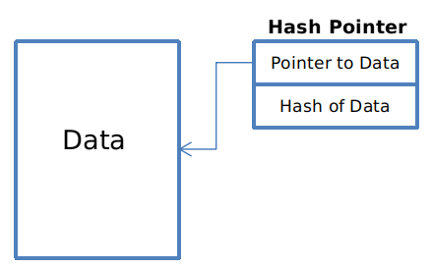
hash pointer is:
* pointer to where some info is stored, and
* (cryptographic) hash of the info
if we have a hash pointer, we can
* ask to get the info back, and
* verify that it hasn’t changed

Slide 3
H( )
(data)
will draw hash pointers like this

Slide 4
key idea:
build data structures with hash pointers

Slide 5
linked list with hash pointers = “block chain”
H( )
prev: H( )
prev: H( )
prev: H( )
data
data
data
use case: tamper-evident log

Slide 6
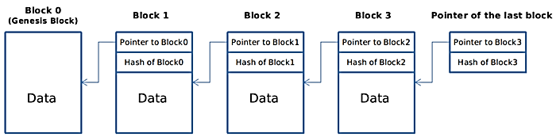
linked list with hash pointers = “block chain”
each block not only tells us where the value of the previous block was, but it also contains a digest of that value that allows us to verify that the value hasn’t changed.

Slide 7
Assignment 01
Create a Blockchain in golang https://golang.org
It will make it very easy to do network programming – a task for next assignments.

Slide 8
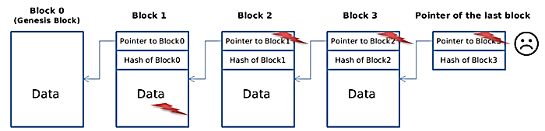
detecting tampering
use case: tamper-evident log
An attacker wants to tamper with one block of the chain, let’s say, block 1.
The attacker changed the content of block 1, because of “collision free” property of the hash function, he is not able to find another data which has the same hash with the old one. So now the hash of this modified block is also changed.

Slide 9
detecting tampering
use case: tamper-evident log
To avoid others noticing the inconsistency, he also needs to change the hash pointer of that block in the next block, which is block 2.
Now the content of block 2 is changed, so to make this story consistent, the hash pointer in block3 must be changed.
Finally, the attacker goes to the hash pointer to the last block of the blockchain, which is a roadblock for him, because we keep and remember that hash pointer.

Slide 10
binary tree with hash pointers = “Merkle tree”
H( ) H( )
H( ) H( )
H( ) H( )
H( ) H( )
H( ) H( )
H( ) H( )
H( ) H( )
(data)
(data)
(data)
(data)
(data)
(data)
(data)
(data)

Slide 11
Application: InterPlanetary File System (IPFS
Today's web is inefficient and expensive
Today's web uses location based addressing – this leads to redundancy

Slide 12
The centralized web: Location-based addressing
URLs are based on the location where data is stored,
Through the domain name, URLs indicate which authority we should go to for the data.
This also results in lot of redundancy

Slide 13
The decentralized web: Content addressing
On the decentralized web, we can host each other's data
Cryptographic hashing enables content addressing
Hashes can be derived from the content of the data itself, if hashes are same so is the content
When we want a specific photo of an adorable pet, we ask for it by its content address (hash).
Who do we ask? The whole network!

Slide 14
Data structures - Decentralized Web
The Web is not only data
The content is linked together as well
How can we structure data using content based addressing?

Slide 15
Case Study: Distributing Large Datasets
The person sharing the file is responsible for maintaining the file server and its associated costs
The same server is likely used to respond to all the requests
The data itself may be distributed monolithically, as a single file archive
It’s hard to locate alternative providers of the same data
It’s hard for others to share datasets that build on the original data

Slide 16
Case Study: Distributing Large Datasets
Anybody who wants can help distribute the file
Nodes from all over the world can participate in serving the data
Each part of the DAG has its own CID that can be distributed independently
It’s easy to find alternative providers of the same data
The nodes forming the DAG are small, and can be downloaded in parallel from many different providers
Larger datasets encompassing the original can simply link the original dataset as a child of a larger DAG

Slide 17
…back to bitcoin
H( ) H( )
H( ) H( )
H( ) H( )
H( ) H( )
H( ) H( )
H( ) H( )
H( ) H( )
(data)
(data)
(data)
(data)
(data)
(data)
(data)
(data)

Slide 18
binary tree with hash pointers = “Merkle tree”
Merkle trees are used in bitcoin to summarize all the transactions in a block, producing an overall digital fingerprint of the entire set of transactions, providing a very efficient process to verify whether a transaction is included in a block.
The merkle tree is constructed bottom-up. In the following example, we start with four transactions, A, B, C, and D, which form the leaves of the merkle tree, as shown in the Figure.
The transactions are not stored in the merkle tree; rather, their data is hashed and the resulting hash is stored in each leaf node as HA, HB, HC, and HD:
HA = SHA256(SHA256(Transaction A))

Slide 19
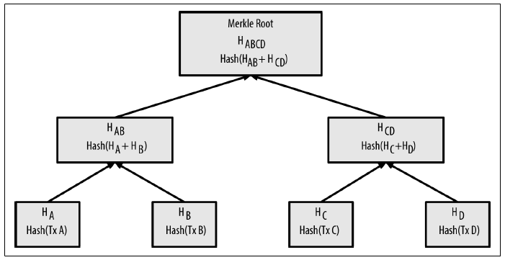
binary tree with hash pointers = “Merkle tree”
Notes:
Merkle tree is a binary hash tree building with hash pointers. The leaves are data blocks, nodes further up in the tree are the hashes of their respective children.

Slide 20
Because the merkle tree is a binary tree, it needs an even number of leaf nodes. If there is an odd number of transactions to summarize, the last transaction hash will be duplicated to create an even number of leaf nodes, also known as a balanced tree.

Slide 21
Why they are used?
They serve many purposes,
  They can be used to verify membership in O(log n) time/space
  Membership of transaction in a block !!
  We can use something called a “Merkle proof” to show that some content is part of this tree. For example, let’s prove that A is part of the above tree. All we need to do is provide each of A’s siblings on the way up, recompute the tree, and make sure everything matches.

Slide 22
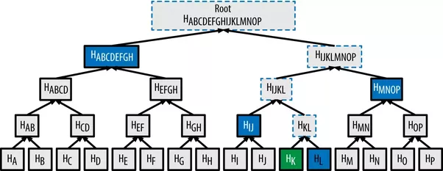
Example
Is transaction K part of the tree?
Notes:
https://www.quora.com/Cryptography-How-does-a-Merkle-proof-actually-work

Slide 23
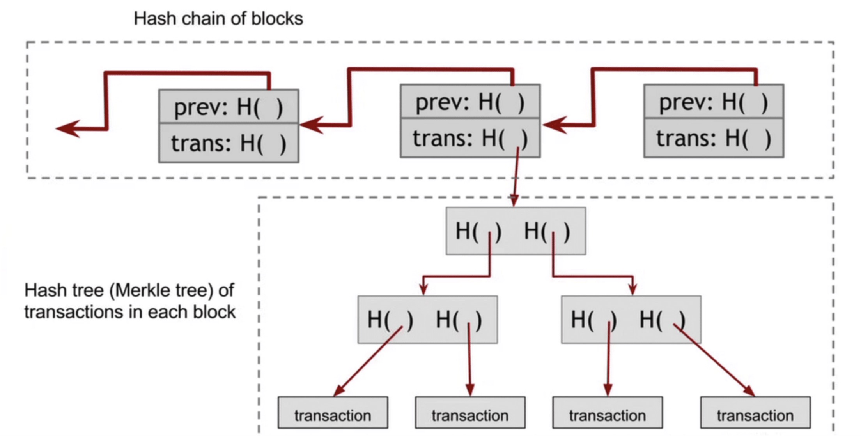
Where they are used?

Slide 24
Where they are used?
A light client may need fewer details.
Can verify membership in O(log n) time/space

Slide 25
Simplified Payment Verification
It should be possible to verify that a certain transaction has happened
The node thus needs to access the blockchain and may need a full local copy
This is a lot to do!! Is it possible to verify bitcoin payments without running a full network node?

Slide 26
Transaction verification
What is needed to verify that a transaction has happened?
  It must be included in a block which must be in the longest chain (not orphan)
  The block must have valid chain of previous blocks back to the genesis block
How to do that on a regular node?

Slide 27
Merkle Trees in Bitcoin

Slide 28
Simplified Transaction Verification
How merkle trees can help?
  The size of block header is small as they only contain merkle root.
  For a block header size of 80 bytes (like Bitcoin) it requires blockheight * 80 bytes. At height 530361 it requires 40 Megabytes.

Slide 29
Simplified Transaction Verification
How merkle trees can help for verifying transaction inclusion in a block?
  We do not need to have all the hashes.
  The merkle proof will always consist of one hash for every step up the tree.
  A block of 16 transactions would require 4 hashes
  For 1000 transactions – 10 hashes. Average is more than 2500 transaction these days!

Slide 30
Do not distribute ...
These slides are not always prepared by me.
Most of the content comes from the reference book
  Bitcoin and Cryptocurrency Technologies: A Comprehensive Introduction
  Arvind Narayanan, Joseph Bonneau,
  Edward Felten, Andrew Miller, Steven Goldfeder

